Slide 1


Networking for Big Data Faculty of Data Science, Sapienza University of Rome Academic Year 2020-2021 Phd Student Davide Aureli
Laboratory Session, NETWORKING for BIG DATA
Prof. Antonio Cianfrani and Prof. Andrea Baiocchi
Speaker: Dr. Davide Aureli
E-mail: davide.aureli@uniroma1.it

Slide 2
Network Traffic Analysis

Slide 3

Lecturer

Slide 4
Course Organization
These Lab sessions can be divided in two typologies:
Lecture and code all together
Final Project Assignment

Slide 5
General Information
We strongly suggest you to follow the lectures with your laptop.
Every time we will observe some code part, it is better that you will try to reimplement each part of the script,
this is the only way to become more confident.

Slide 6


Group Project (HOW ?)
Group Rule: It is possible to use the groups formed with Prof. Baiocchi
Presentation: each group will present the work (15 min), preparing a set of slides to comment the results

Slide 7


Group Project (WHEN ?)
All groups will have the possibility to work exploiting lesson time
During the working time in class you can ask every questions or clarification

Slide 8
IMPORTANT: Group Composition
Please, send just one email for each group to davide.aureli@uniroma1
with all the names of the components.
Otherwise, you can update the Excel file shared at this link:
https://drive.google.com/drive/folders/1YMwwPoekwJrw_-UYkZYUkTFqC8bqAy0F?usp=sharing

Slide 9
IMPORTANT: Deadline
The project will start during class hour, and everything that remains uncomplete will be finished by July.
The oral exam will be scheduled all together with Prof. Cianfrani

Slide 10
IMPORTANT: Material
All the material is available at:
https://github.com/davaureli/NBD_LabSession
Copy this repository !

Slide 11





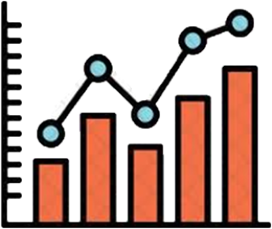
Brain Storming

Slide 12

Road Map
Lecture 3
Lecture 2
Lecture 1
Project

Slide 13
Course Topics
1) Wireshark
2) PyShark
3) Machine Learning (ML) with traffic data

Slide 14
Wireshark – Lecture 1

Slide 15

From Theory to Practice
Until now you have received a complete explanation about Networking Fundamentals
Now it’s time to implement something from scratch

Slide 16

From Theory to Practice
Which kind of projects ?
How a Data Scientist may contribute with his knowledge ?

Slide 17
What is Wireshark ?
Wireshark is a network packet/control analyzer, available for UNIX and Windows.
Protocol analyzer that listens to the network, analyzing the data in transit, highlighting the peculiarities.

Slide 18
Intended Purposes
Observing the different analysis made within Wireshark, we take the inspiration to implement something similar for our ML Project.
But now let’s start to install Wireshark !

Slide 19
Installation
Under Windows: https://www.wireshark.org/docs/wsug_html_chunked/ChBuildInstallWinInstall.html
Under macOS: https://www.wireshark.org/docs/wsug_html_chunked/ChBuildInstallWinInstall.html
Under Unix:
https://www.wireshark.org/docs/wsug_html_chunked/ChBuildInstallUnixBuild.html

Slide 20
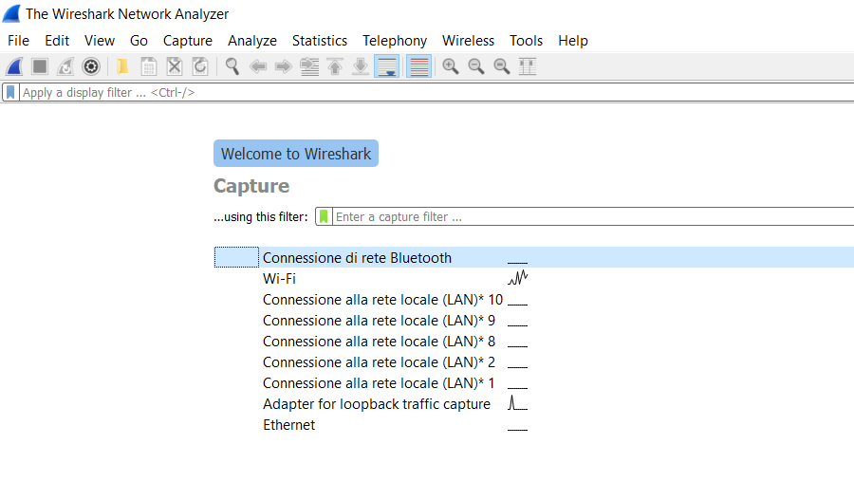
At first glance
Specify the network interface
on which to activate the capture

Slide 21
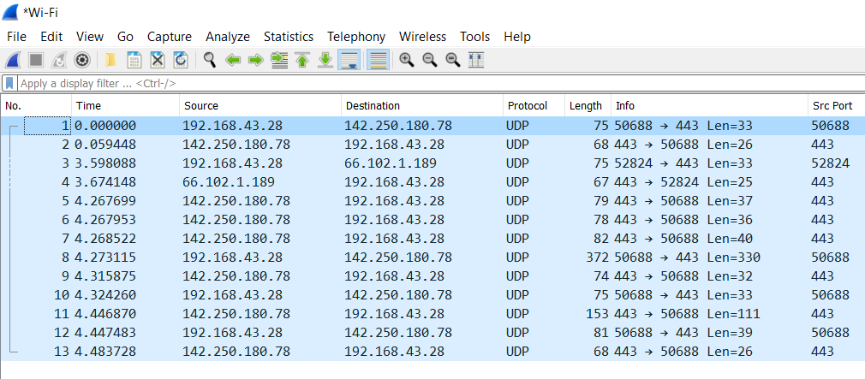
First analysis

Slide 22
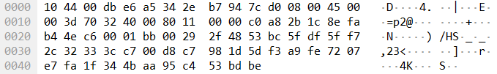
First analysis

Slide 23
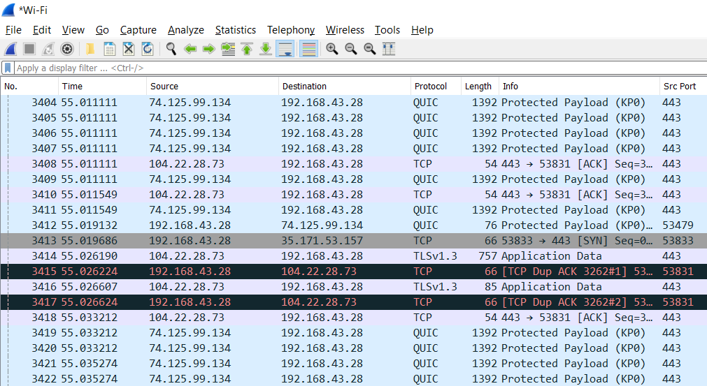
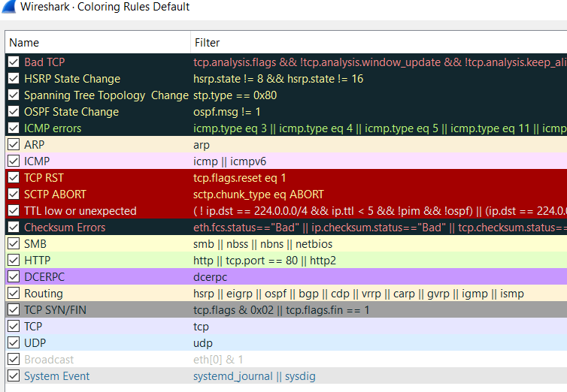
As many colors as rules
Click on → VIEW → COLORING RULES …
**We can also custumized them

Slide 24
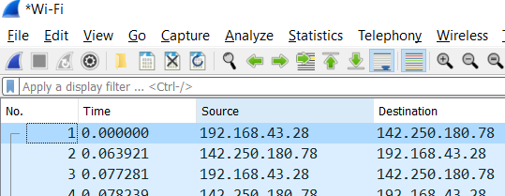
Filtering sniffed trace
Here we can apply different filters written with a precise format
(as an SQL query)

Slide 25
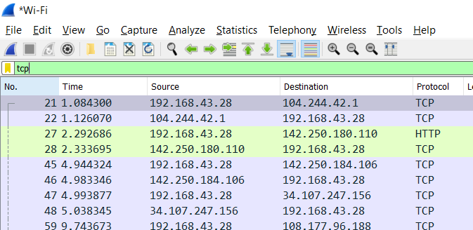
Filtering sniffed trace

Slide 26
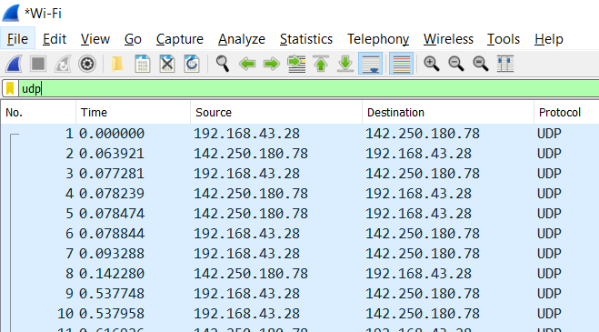
Filtering sniffed trace

Slide 27
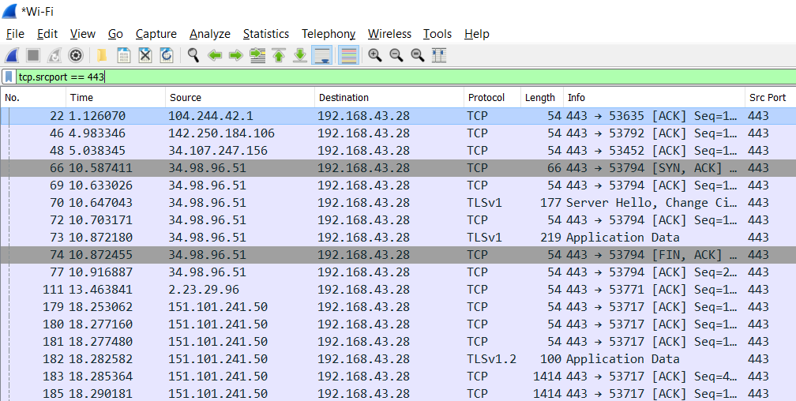
Filtering sniffed trace

Slide 28
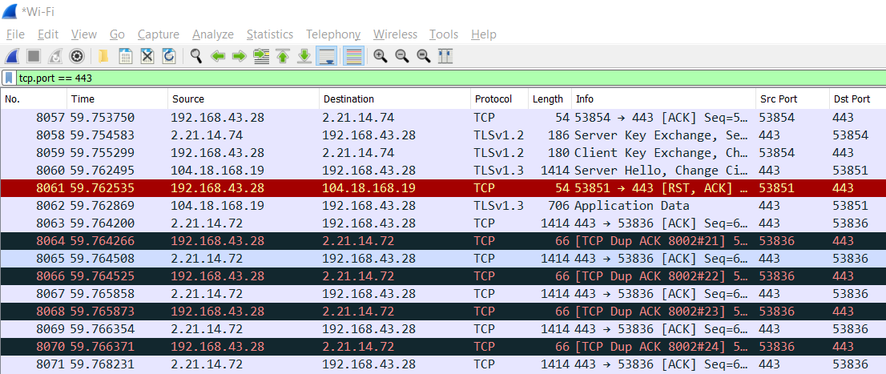
Filtering sniffed trace

Slide 29
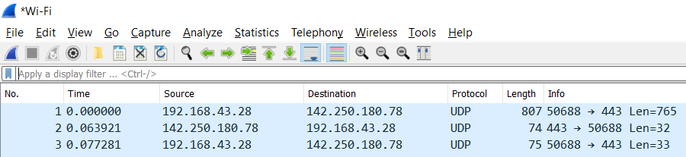
Statistics
Every time we talk about data our beloved statistics comes out

Slide 30
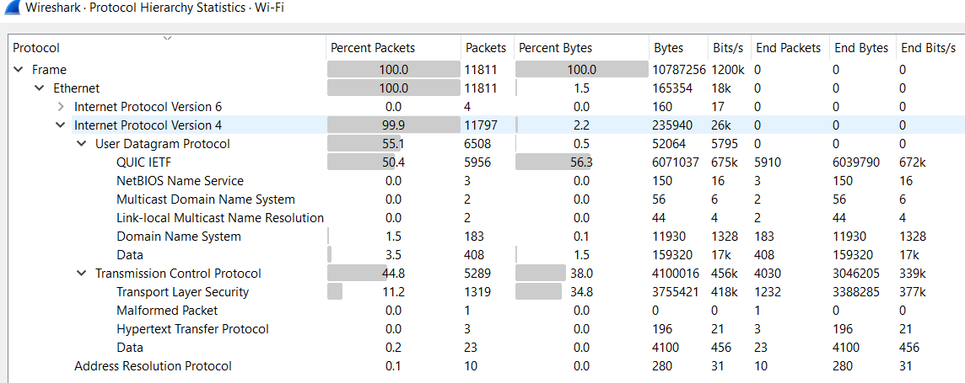
Statistics → Protocol Hierarchy

Slide 31
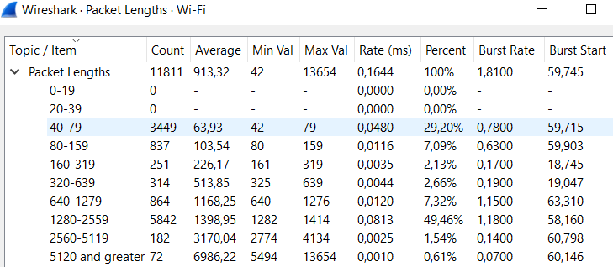
Statistics → Packet Lengths

Slide 32
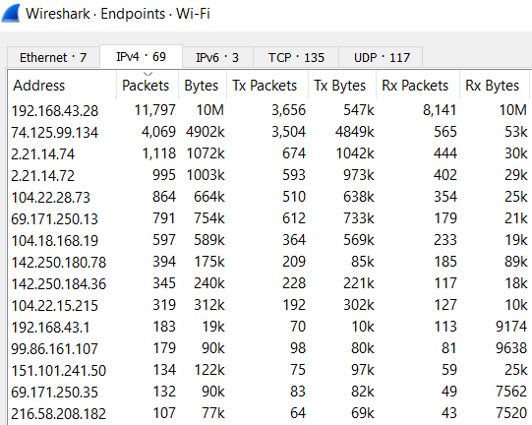
Statistics → Endpoints

Slide 33
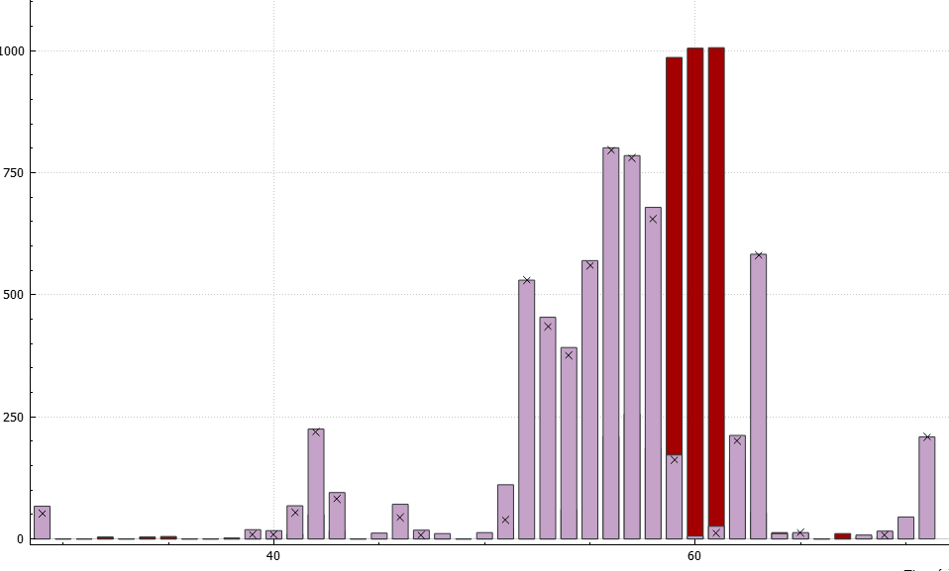
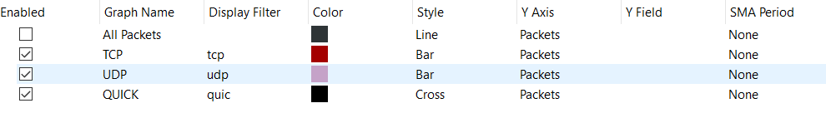
Statistics → I/O Graphs
Pkt/sec
Time(sec)

Slide 34
.pcap file
If we want to save our Packet-CAPture to reuse another time we need to save it in a pcap format.
Now, every time you will hear someone to talk about pcap file you’ll recognize it.

Slide 35
Pyshark – Lecture 2

Slide 36
Until now we have seen different tools provided by Wireshark, but at the same time we lose some degree of freedom.
Our idea is to investigate an alternative methodology to work with the same type of data but reaching similar results, and at the end build our own challenge.

Slide 37
“ Hello Pyshark”
Pyshark is a Python wrapper for tshark, allowing python packet parsing using wireshark dissectors.
This package allows parsing from a capture file or a live capture, using all wireshark dissectors you have installed. Tested on windows/linux.
*Reference : http://kiminewt.github.io/pyshark/

Slide 38

Installation
Follow this GitHub to install Pyshark: https://github.com/KimiNewt/pyshark/
Now we’ll go on using the programming language Python 3.
If you want to go deeper studying a valid alternative to pyshark it is suggested to see Scapy (https://scapy.readthedocs.io/en/latest/)

Slide 39
Let’s start from .pcap file
We can retrieve the pcap file saved from the last session with Wireshark and try to read our trace through Python.
*ReadPcap File
Capinfo different options
Editcap different options

Slide 40
Capinfo
Capinfos is a program that reads one or more capture files and returns some or all available statistics (infos) in one of two types of output formats: long or table.
Reference: https://www.wireshark.org/docs/man-pages/capinfos.html

Slide 41
Editcap
Editcap is a program that reads some or all of the captured packets from the infile, optionally converts them in various ways and writes the resulting packets to the capture outfile (or outfiles).
Reference: https://www.wireshark.org/docs/man-pages/editcap.html

Slide 42
Coding Part
The first coding part will show you how to extract all infos from a pcap file and split it according to time or number of packets.
Code Link : https://github.com/davaureli/NBD_LabSession
Lecture Folder: Lecture 2/Sequential/readPCAP.py

Slide 43
Extraction Field
In this coding part we will use for the first time “pyshark”, and it provides the possibility to gather info from the Ip and transport layer.
Code Link : https://github.com/davaureli/NBD_LabSession
Lecture Folder: Lecture 2/Sequential/readpcap_wireshark.py
This link provides the complete code so both for the field extraction and for the statistical analysis.

Slide 44
Statistical Analysis
Creating Dataframe
IP analysis (top sender and receiver)
BitRate different sampling metrics
GeoLocal referenciation for IP addresses
Analysis flows based

Slide 45
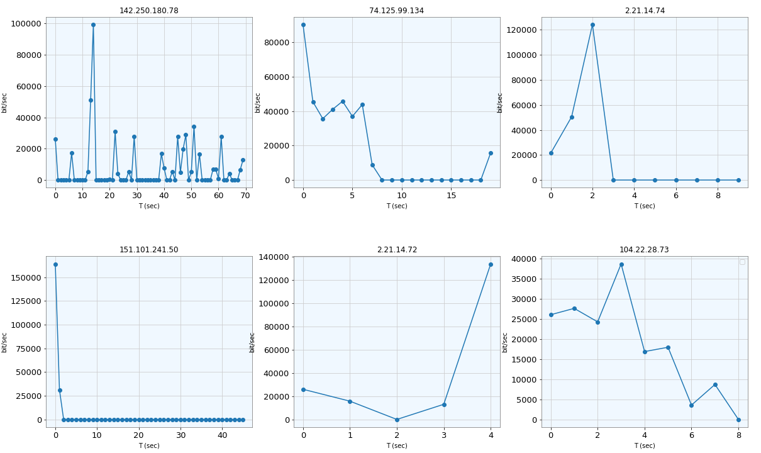
Top Receiver from My IP 192.168.43.28

Slide 46
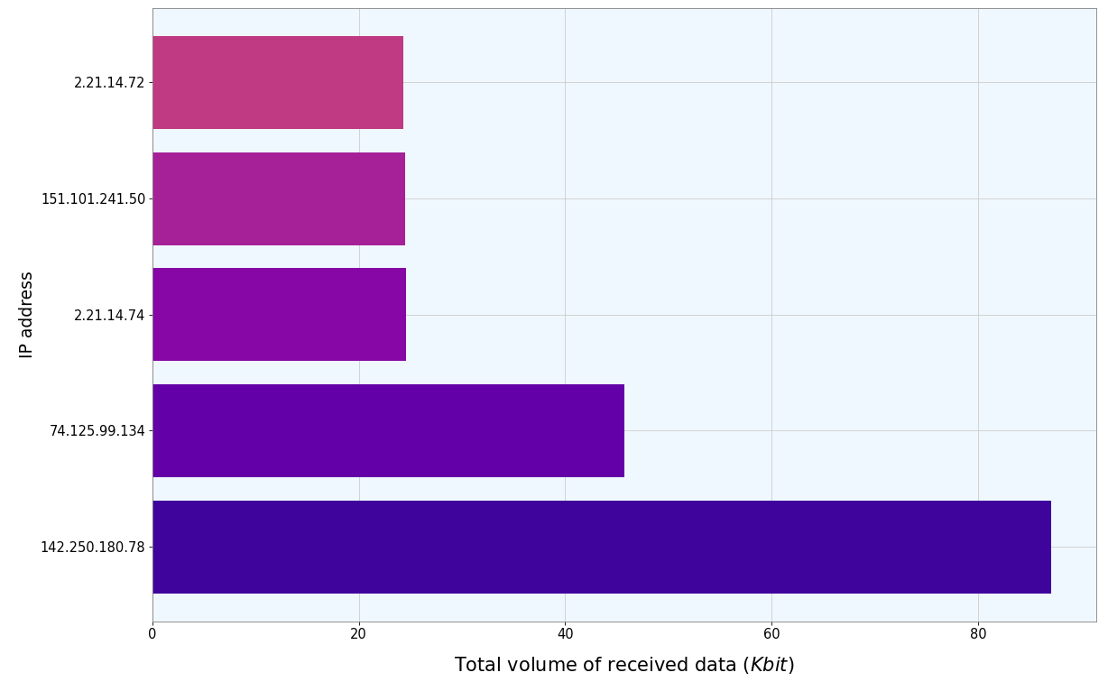
Top 5 Destination for Received Data (excluding My IP)

Slide 47
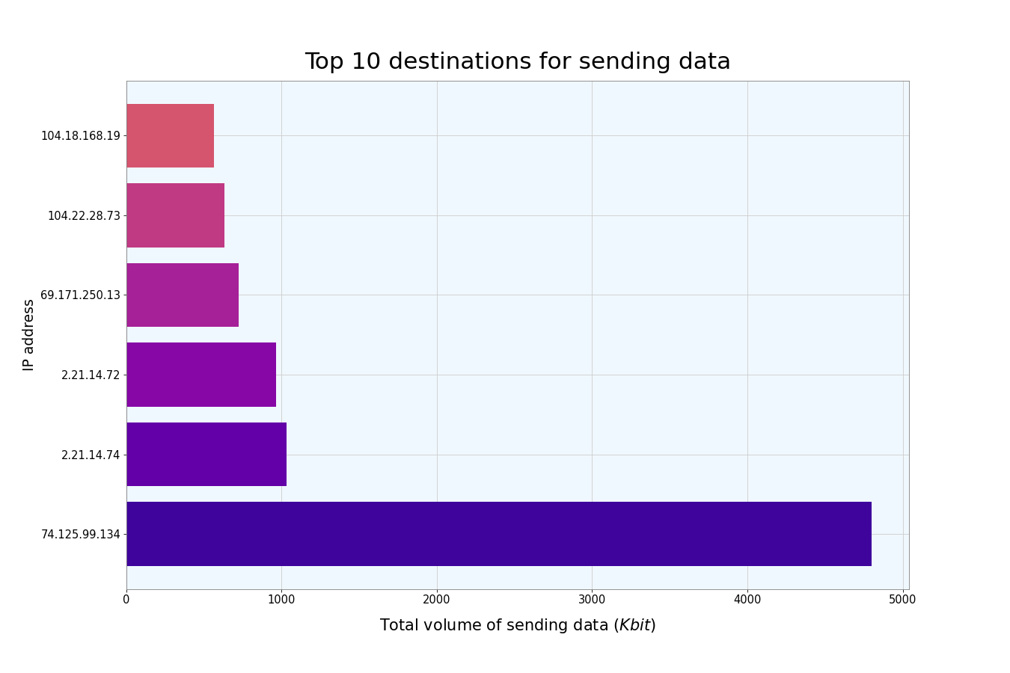
Top 6 Sender IP Addresses

Slide 48
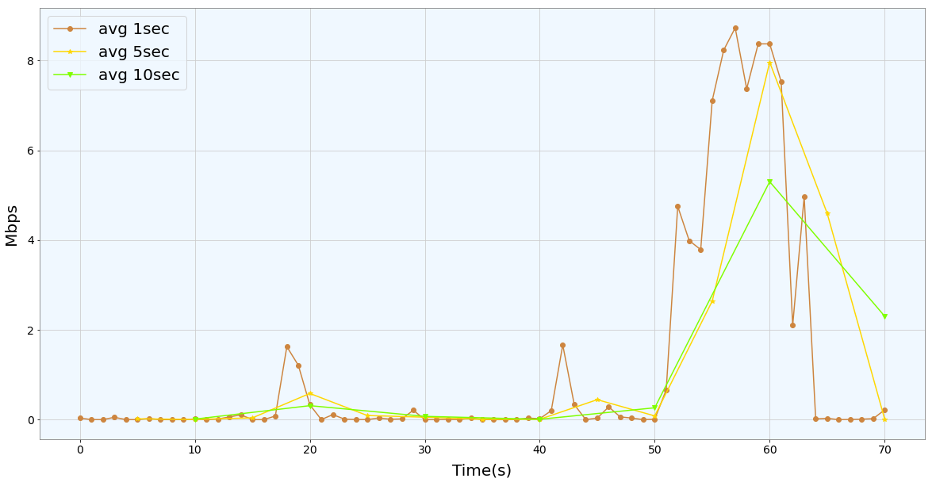
Different sampling BitRate

Slide 49
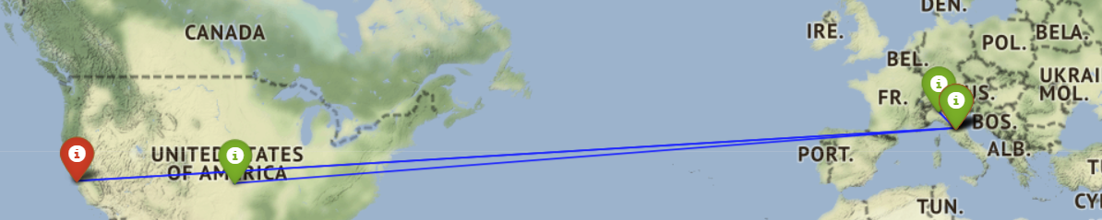
GeoLocal Referenciation
We can use ip2geotools and folium combining their properties to plot the positioning according to Latitude and Longitude of a specific IP src (i-green) and IP dst (i-red)

Slide 50
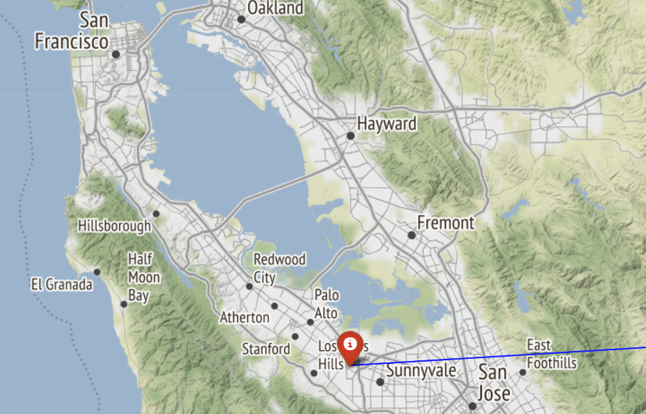
GeoLocal Referenciation (P destination ZOOM)

Slide 51
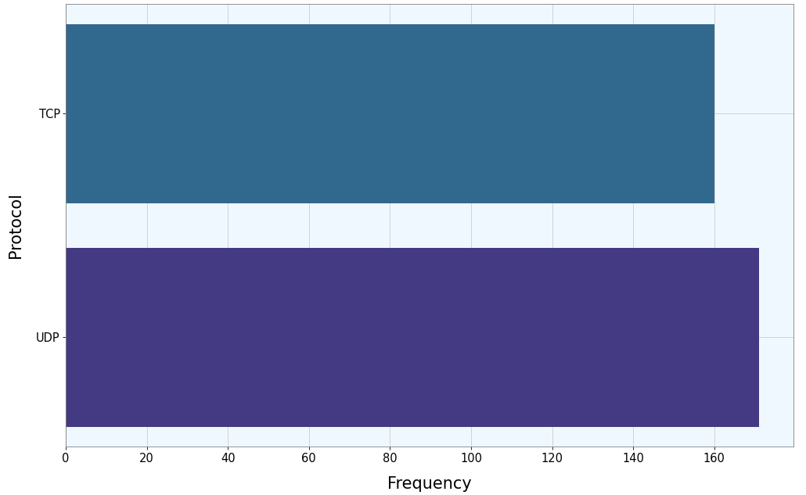
Protocol analysis based on flows

Slide 52
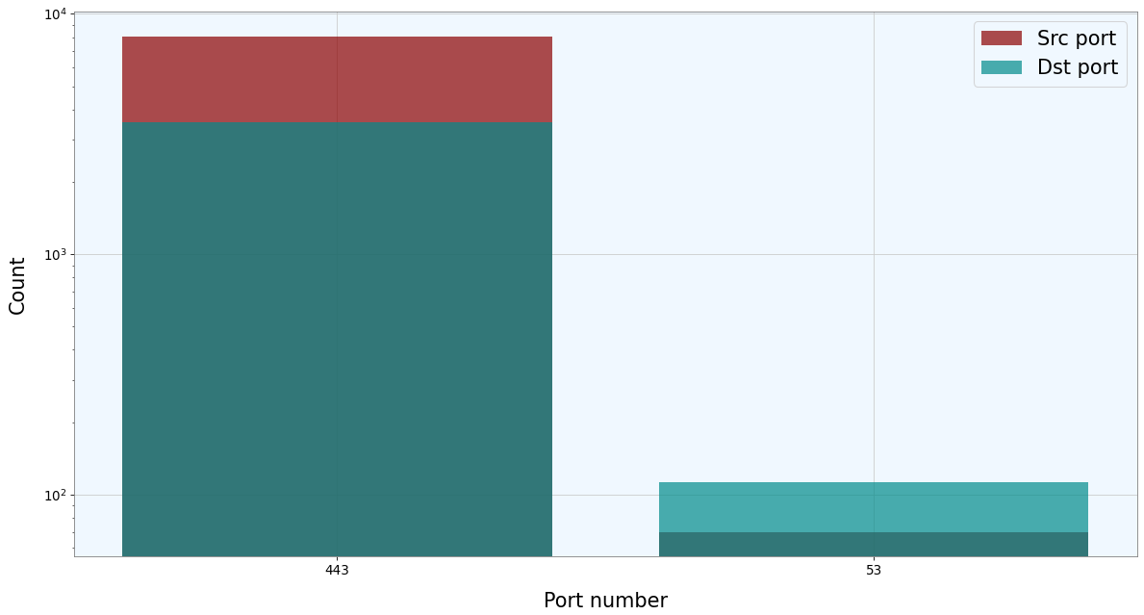
Port Scanner (just Well-Known Ports)

Slide 53
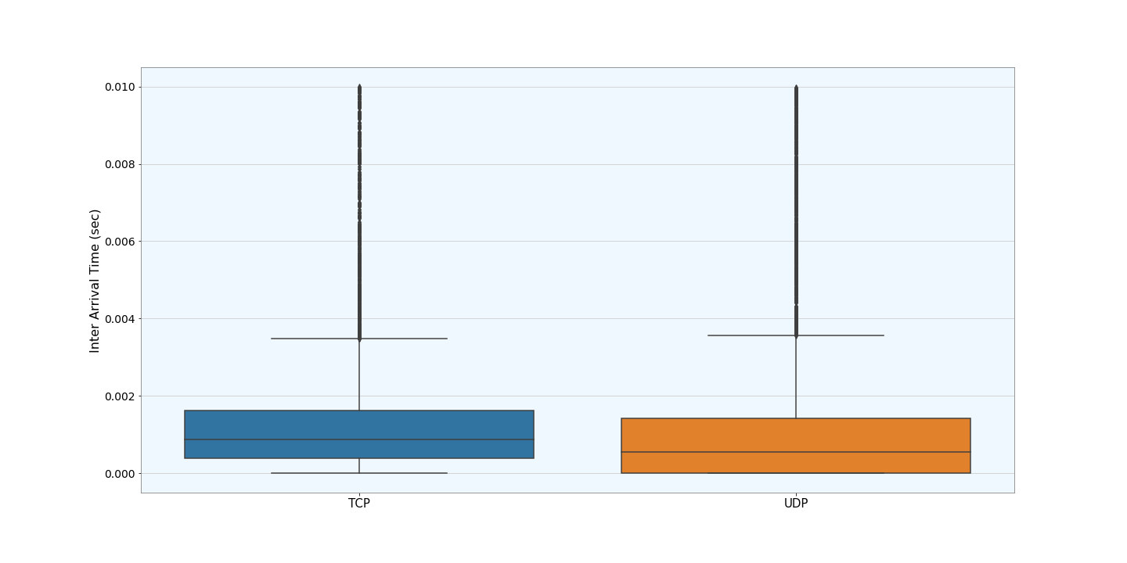
Interarrival Time difference between TCP and UDP

Slide 54
Machine Learning – Lecture 3

Slide 55
Machine Learning Project
Supervised Learning
Unsupervised Learning
Classification

Slide 56
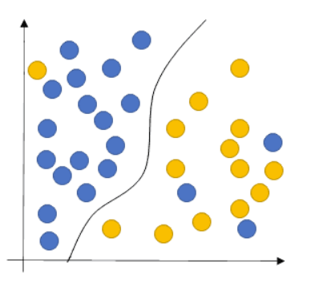
Supervised Learning
Traffic Classification based on a specific label
Our goal is to learn a function that, given a sample of data and desired outputs, best approximates the relationship between input and output observable in the data

Slide 57
Starting from Literature
Our starting point is a work implemented in 2010 :
D. Rossi, S. Valenti - ”Fine-grained traffic classification with Netflow data”
They present an algorithm (Abacus) which successfully exploits Netflow records for traffic classification. Identifying an application by means of the simple counts of received packets and bytes.

Slide 58
Classification methodology
Data:
Netflow measures flow level features
What is a flow ?
Key (5-tuple)= <IP src, IP dst, src Port, dst Port, IP Protocol>
The key identifies a record in memory, storing besides attributes like cumulative packets and bytes counters, flow starting and finishing timestamps.

Slide 59
Classification methodology
Goal: Abacus classifies application endpoints (IP0,p0), focusing the attention on UDP Traffic.
Classes: [Pplive, TVAnts, SopCast, Joost, Edonkey, BitTorrent, Skype, DNS]
The idea is based on the behavioral classification, but it is the first fine-grained classification engine identifying the traffic by the sole examination of their traffic patterns (light-weight approach)

Slide 60
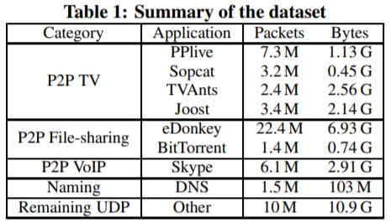
Dataset Description

Slide 61
Classification methodology
IP_{i} , p_{i}
C
IP_{i} , p_{i}
C
IP₀ , p₀
C
IP_{i} , p_{i}
ΔT
The classification is based on the raw count of packets and bytes
received by (IP₀, p₀) from the set C = {(IP_{i}, p_{i})} of N neighboring endpoints
(during an interval ∆T)

Slide 62
Classification methodology
Vector Representation:
They evaluate the distribution of «P-packets» and «B-bytes» representig them as |p| = 1 and |b| = 1
In both distributions is applied the log₂ binning, highlighting the differences for lower counts of packets and bytes
Abacus signatures s:= (p,b)
This represents the training data for the SVM algorithm

Slide 63
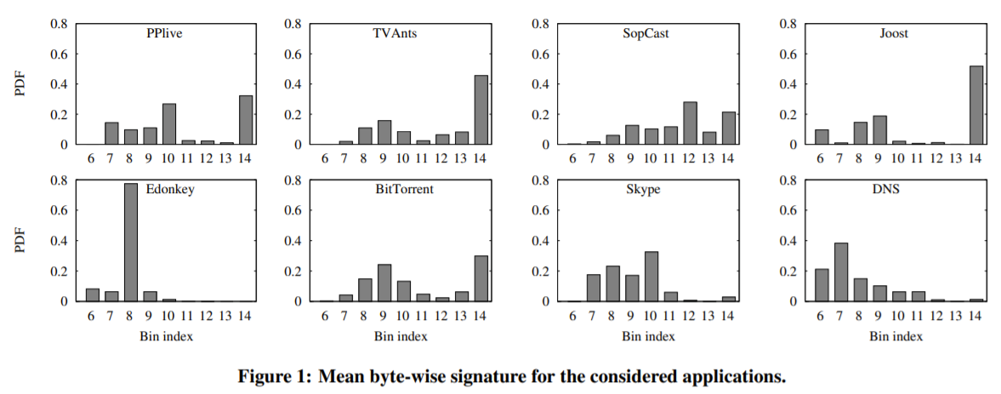
Differentiation between classes

Slide 64
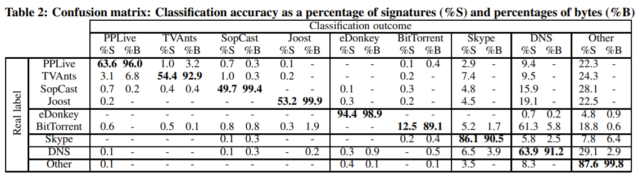
Accuracy Results
Can we replicate this proposal with our own project ?
It’s time to work …

Slide 65
Machine Learning – Code

Slide 66
Project Idea
Replicate supervised work with a different label → DSCP
DSCP stands for Differentiated Services Code Point
The architecture is called DiffServ and its purpose is to improve the QoS in IP traffic with optimal scalability.
It relies on a mechanism to classify packets as belonging to a specific service class (SC).

Slide 67
DiffServ Label
*(DS Field – 8 bits)→ DSCP(6) + ECN(2)
DSCP Value | DSCP Class | Class Label
48,56 | CS6, CS7 | Network & InterNet Control
40,46 | CS5, EF | Critical Voice RTP
32, 34, 36, 38 | CS4, AF4 | Flash Override
24, 26, 28, 30 | CS3, AF3 | Flash Voice
16, 18, 20, 22 | CS2, AF2 | Immediate
8, 10, 12, 14 | CS1, AF1 | Priority
0 | CS0 | Best Effort

Slide 68
Project Idea
In our project we exloit this label but in a summarized way:
Best Effort (BF)
Scavenger (called NotKnow in the code)
Assured Forwarding (AF)
Expedited Forwarding (EF)
Network & Internetwork control (NIC)
Dataset: https://mawi.wide.ad.jp/mawi/samplepoint-G

Slide 69
Machine Learning Code
Code Link : https://github.com/davaureli/NBD_LabSession
Lecture Folder: Lecture 3

Slide 70
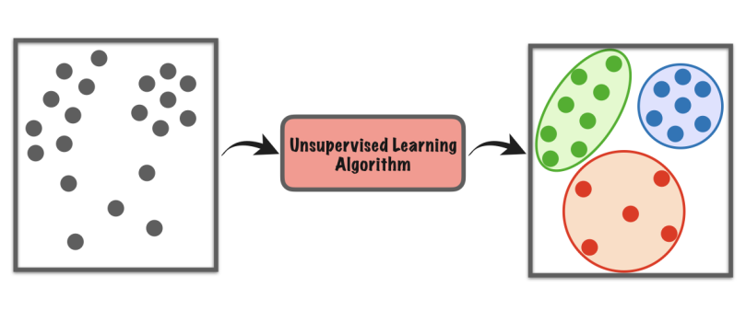
Unsupervised Learning
Traffic Classification based on unlabelled data
The model works to discover patterns and information that was previously undetected

Slide 71
Starting from Literature
Our starting point is a work implemented in 2009 :
Y. Zeng, T.M. Chen - ” Classification of Traffic Flows into QoS Classes by Unsupervised Learning and KNN Clustering”
They use K-means clustering as unsupervised machine learning methods to identify the inherent classes in traffic traces.

Slide 72
Dataset
Data: The traffic was separated into flows by the quintuplet {IP Src, IP Dst, Protocol, src-port, dst-port}
Applications: HTTP, FTP, DNS, telnet
Idea: Traffic flows are classified into QoS classes, flows within the same QoS class share similar service requirements

Slide 73
Variables
Candidate Feature:
• packet level: packet length statistics (max, min,μ,var);
• flow level: statistics of number of packets per flow, number of bytes per flow, flow duration, interarrival times;
• TCP connection level: statistics of packets per TCP connection, bytes per connection, connection duration

Slide 74

K-Means
K-Means finds the optimal solution by minimizing the square distance:
K:# clusters
c: # centroids
n:items
Working without «a priori» knowledge aboute the optimal number of clusters (k), it is determined by the elbow method analysis.
The optimal number of centroids minimizes the sum of distance

Slide 75
Fast view on results
Discovered 3 clusters: DNS , Telnet and FTP control, HTTP.
DNS → small avg packet size,
short connection duration time
Telnet and FTP control → small avg packet size,
long connection duration
HTTP → medium/large avg packet size,
low/medium connection duration

Slide 76
From clusters to QoS Class
In the last analysis the authors observed that the K-Means results replicate the applications differentiation based on QoS requirements provided by Roughan et al[1]
[1]Roughan et al, “Class-of-service mapping for QoS: a statistical signature-based approach to IP traffic classification,”
Application | QoS Class
DNS | Transactional
Telnet and FTP control | Interactive
HTTP | Bulk transfer

Slide 77
Project Assignment (Dataset)
Data:
https://drive.google.com/drive/folders/1YMwwPoekwJrw_-UYkZYUkTFqC8bqAy0F?usp=sharing
This dataset is provided by the Mawi Project, the total amount of the trace is 5Mln of packets retrieved from the traffic trace of 10/04/2019.
(https://mawi.wide.ad.jp/mawi/samplepoint-G/2019/201904101400.html)

Slide 78
Project Assignment
Extract 1 million of packets from the available data, replicate the statistical analysis observed during Lecture 2. FOLLOW the LIST!
Extract general info from your trace using capinfos;
Time Evaluation between Sequential and Parallel reading;
Extract the IP which generates the highest amount of sender traffic, evaluate the bit rate (0.1 sec) for the 6 IP addresses mostly used as endpoint
Top 5 Destination IP (received bytes) and Top 5 Source IP (sent bytes)

Slide 79
Project Assignment
5) Evaluate bitRate considering all the trace with 3 different sampling rate
6) GeoLocal Referenciation of the 5 sessions with the highest amount of traffic generated;
7) 10 Protocol mostly used;
8) Port Scanner evaluation (10 Ports mostly used);
9) InterArrival Time boxplot between TCP and UDP Sessions;

Slide 80
Project Assignment
10) Develope your own analysis (e.g. Topology of the network using networkx or evaluation about a variable such as TTL) (BONUS)

Slide 81
Project Assignment
B) Using the same dataset, you can cut the time interval as you want trying to replicate or Supervised or Unsupervised classification problem.
Summarizing results according to the accuracy and other metrics related to the label(**) considered, you can add the more variables w.r.t. the paper analyzed but remember you must work with flow based features.
**You can both replicate DSCP analysis or change the label for example classify TCP and UDP. You have complete freedom about the label and the algorithm for classification

Slide 82

Thank you for your attention !
Mail: davide.aureli@uniroma1.it

